Slide 1
Head Pose Changer
Shah Aalap Anil (150655)
Course Project for EE604: Image Processing
Instructor: Prof. K Venkatesh
10th November, 2019

Slide 2
Objective
Develop an application using MATLAB GUI which will receive the image of an individual as input, and then:
Detect the face/head
Turn the face/head slightly in all four directions according to user input.

Slide 3
Procedure

Slide 4
Can be done using a facial landmarks library (option for manual input)
Pixels within triangle transformed linearly based on vertices
Algorithmically or Manually
Detect Facial Landmarks
Find and Plot Bounding Box
Triangulate Face into Polygons
Transform Landmarks
Transform Each Triangle & Resample
This simply shows the detected face (trivial)
Using user input and a hard-coded depth estimate for each landmark

Slide 5
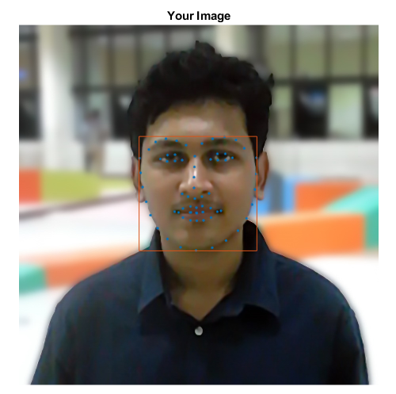
Sub-Task 1
Facial Landmark Detection:
MATLAB interface for OpenCV library called dlib
Detects landmarks by classifying HOG features using a pre-trained SVM
Library used: https://github.com/YuvalNirkin/find_face_landmarks

Slide 6
Sub-Task 1
Facial Landmark Detection:
The MATLAB GUI plots the landmarks by overlaying a scatter plot over the image
Bounding box of the landmarks plotted to show the detected face

Slide 7

Sub-Task 1
Fail-Safe:
Added option to manually select landmarks for an image where they are not detected
Reference image with landmark positions shown

Slide 8
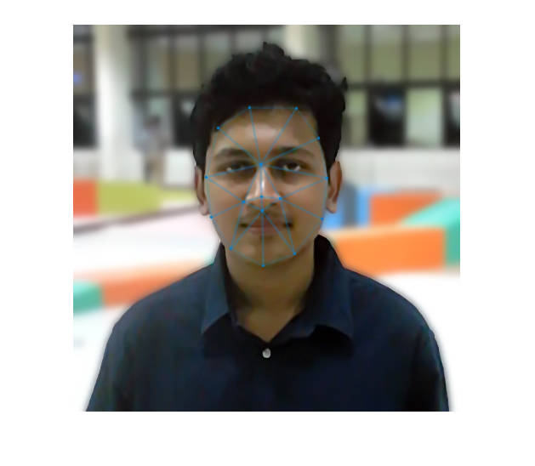
Sub-Task 2
Triangulation:
Before transforming the image, it is divided into polygons
Can be done algorithmically, but since the number of landmarks are fixed, the triangulation is defined manually (as shown).

Slide 9
Sub-Task 3
Vertex Transformation:
Each point moved by an amount based on its expected depth (for example, nose tip moved more, eye centre moved less)
Direction and mean magnitude based on user input
For each triangle, a transformed triangle is obtained
Pixel Transformation:
For each pixel (x, y) that lies within a triangle, it is transformed linearly along with the vertices of the triangle
Pixel location expressed as linear combination of side vectors and then transformed to the same linear combination of transformed side vectors
New pixel locations are not integers

Slide 10
Sub-Task 4
Resampling:
Since each pixel is transformed to a non-integer location, the new image may have gaps/overlaps if they are simply rounded off
Each channel is taken as a function over the non-integer points
The function is sampled using 2D linear interpolation at integer points to get the image
HSV channels used instead of RGB for better output

Slide 11




Results
Tilt Up
Tilt Left
Tilt Right
Tilt Down

